Slide 1
What Really Drives Crop Yield? A Data-Driven Analysis of High-Level, Environmental, and Farming Practice Factors
Pradyumn Singh
29th of august 2024

Slide 2
Our Mission: Finding the "Why" Behind the Harvest
High-Level Performance:
Which region, soil, and crop are the most productive?
Environmental Impact:
What is the role of rainfall, temperature, and weather?
Farming Practices:
How significant are irrigation, fertilizer, and harvest duration?
The Ultimate Question:
Which combination of factors is the most powerful predictor of yield?

Slide 3
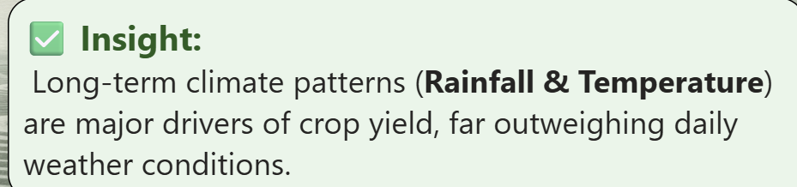
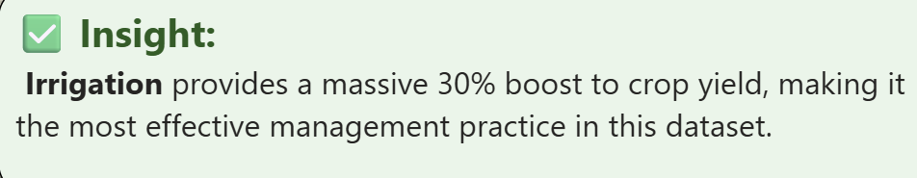
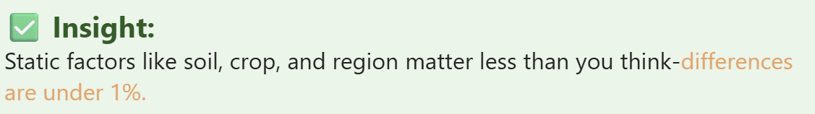
The Verdict: Water and Temperature Are the Game Changers
Water is King:
Rainfall and irrigation are the most dominant factors, with irrigation alone boosting yields by 30%.
Heat Helps:
Warmer temperatures consistently lead to higher yields.
The Rest is Detail:
Static factors like region, soil type, and daily weather have a minimal impact (<1% difference).

Slide 4
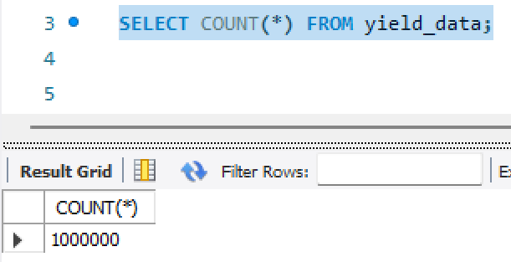
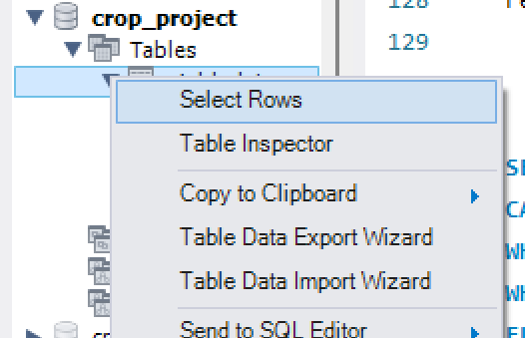
Forging the Dataset: From Raw Data to Actionable Insights
Challenge 1: Large Data Ingestion
Problem: Loading the 1 million+ row CSV file into MySQL failed using standard import wizards due to its size and complexity.
Solution: Used Python to programmatically inspect the file headers, validate the true data schema, and build the correct SQL table structure for a clean import.
Challenge 2: Schema Validation & Correction Problem: Initial analysis was blocked by mismatches between assumed and actual column names in the raw file.
Solution: Used Python to programmatically inspect the file headers, validate the true data schema, and build the correct SQL table structure for a clean import.

Slide 5
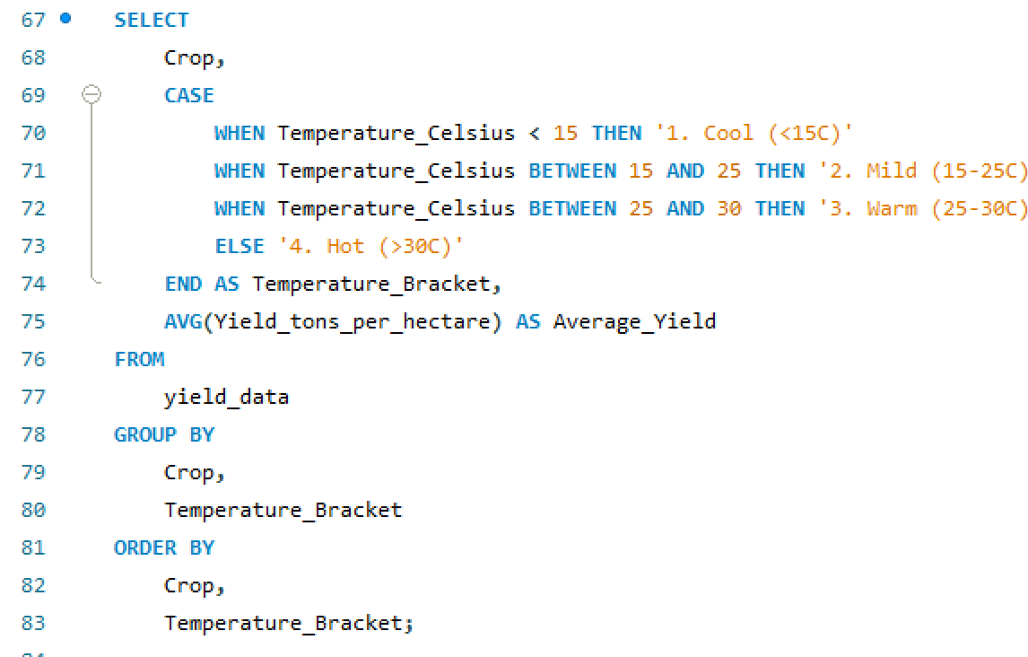
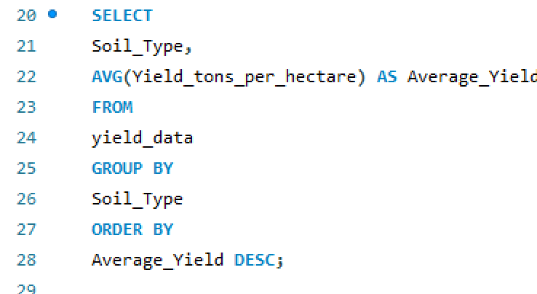
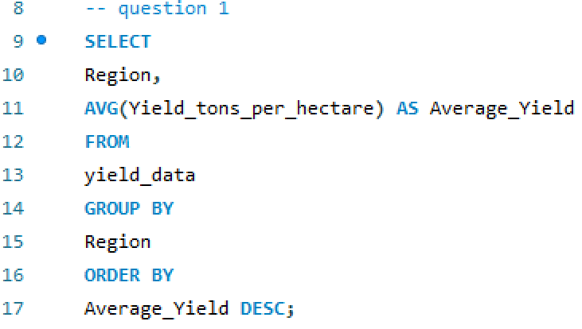
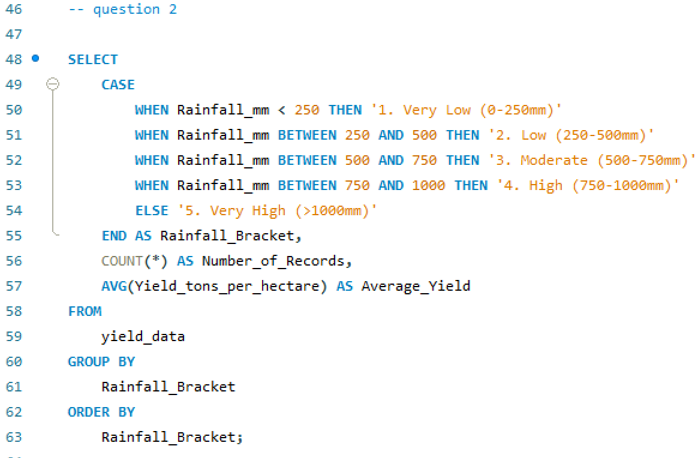
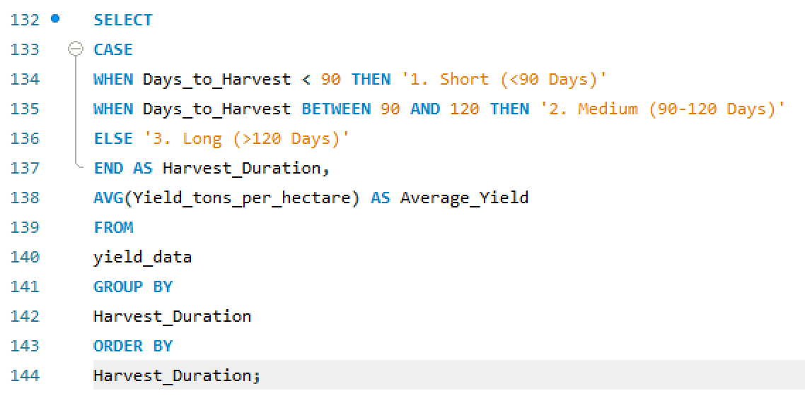
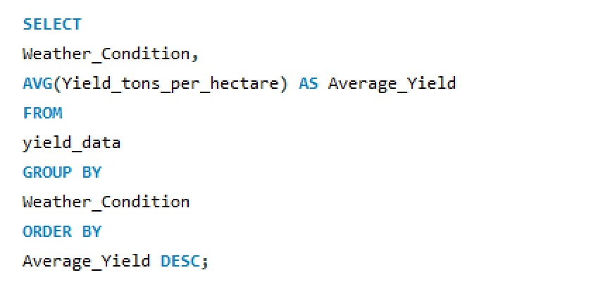
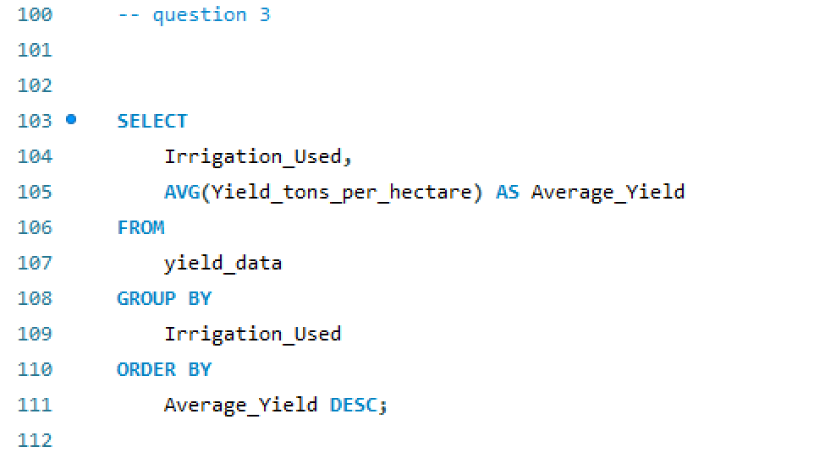
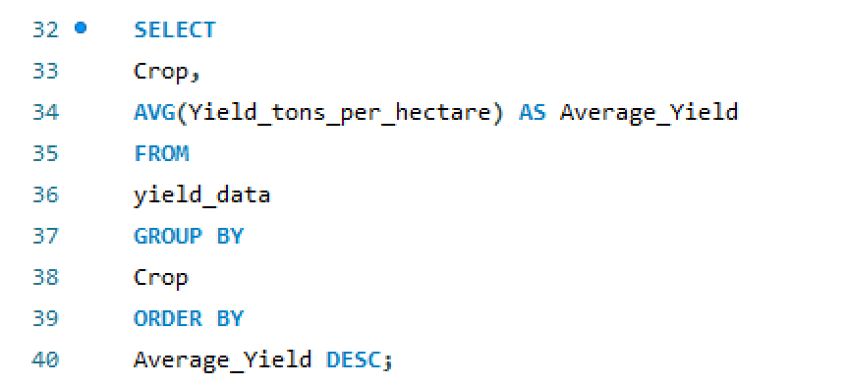
Challenge 3: Data Type Unification
Problem: Boolean data (True/False) was imported as text, preventing calculations in Power BI.
Solution: Utilized Power Query to transform the boolean text into a numerical format (1/0), enabling the creation of DAX measures like "Irrigation Rate.
Challenge 4: Feature Engineering (Binning)
Problem: It was difficult to see trends in continuous numerical data like Rainfall and Temperature.
Solution: Transformed the numerical data into categorical "brackets" (e.g., 'Low', 'Moderate', 'High') using DAX calculated columns, a technique known as binning, to make trend analysis clear and simple.

Slide 6
Do Static Factors Like Location and Soil Matter?
Our initial analysis set out to identify the single most influential factors affecting crop yield by looking at performance across regions, soil types, and crop varieties. While we did find the top performers in each category—North region, Chalky soil, and Soybean crops—the key takeaway is this: the differences between categories are extremely small. There’s no single “magic factor” driving higher yields; instead, it’s likely a combination of multiple variables that truly matters.
Finding 1: North Region Slightly Leads in Productivity
Finding 2: Chalky Soil Shows Marginal Advantage
Finding 3: Soybeans Slightly Outperform Other Crops

Slide 7
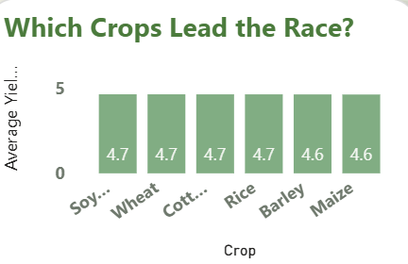
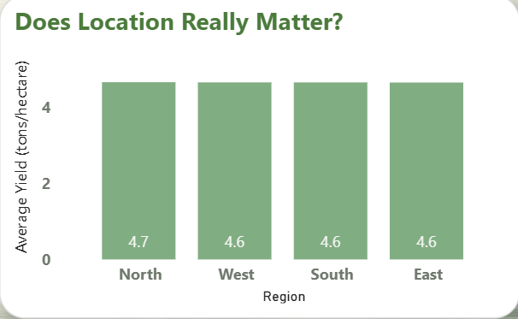
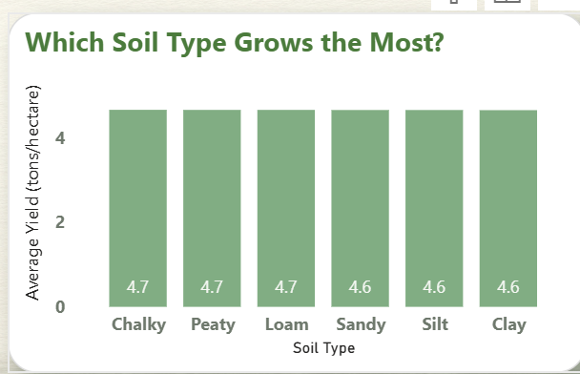
Key Insight:
The difference between the highest and lowest regions is less than 0.2%, which means geography alone doesn’t have a major impact on yield.
Just like with regions, the variation between soil types is minimal. Soil type matters, but not as much as we might expect.
While Soybeans lead, Wheat and Cotton are right behind. Crop choice alone isn’t a strong differentiator in this dataset.
Conclusion
Yes, we can identify leaders in each category, but the real story is how consistent the yields are across all factors. The tiny gaps suggest that factors like region, soil, and crop type don’t fully explain yield differences. The next step is clear: we need to dig deeper into dynamic factors like rainfall, temperature, and other environmental conditions to uncover what truly drives higher productivity.eans Slightly Outperform Other Crops

Slide 8
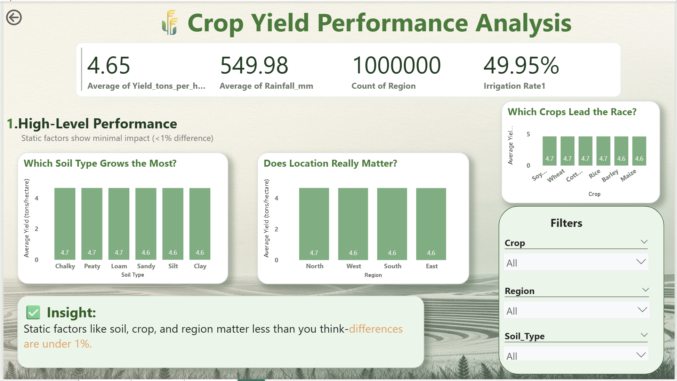

Slide 9
Rainfall & Temperature: The True Drivers of Yield
Our analysis clearly shows that climate-related factors like rainfall and temperature have the biggest influence on crop yield. These two variables show a much stronger relationship with yield compared to static factors such as region, soil type, or even the type of crop. While sunny days offer a small advantage, day-to-day weather conditions have very little impact compared to the broader climate trends.
Finding 4: Rainfall is a Critical Driver of Crop Yield
Finding 5: Warmer Temperatures Consistently Increase Yields
Finding 6: Sunny Conditions are Marginally Favorable

Slide 10
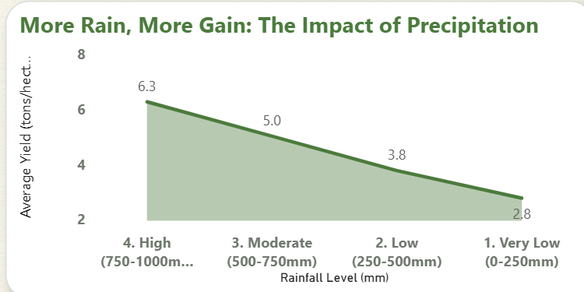
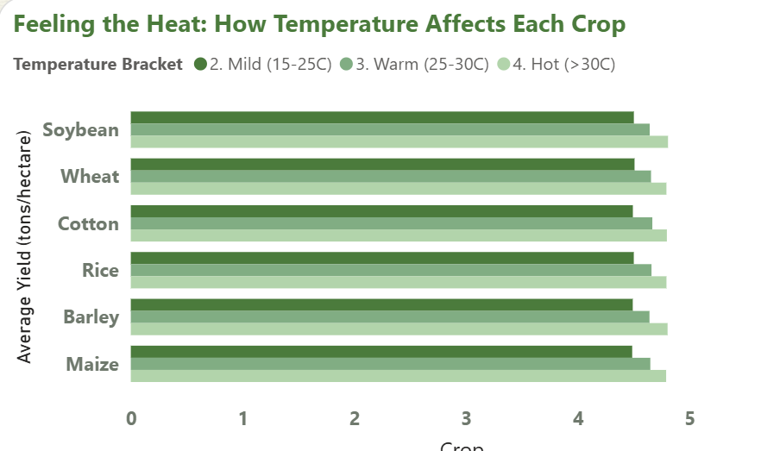
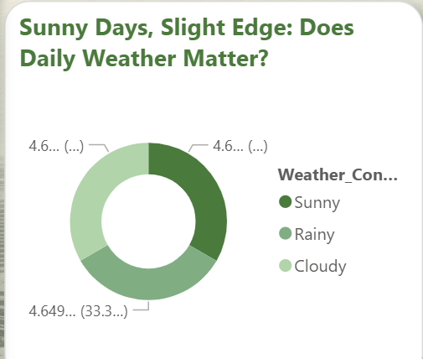
Overall Conclusion
Water availability (Rainfall) and heat (Temperature) are the most significant environmental drivers of crop yield in this dataset. The negligible impact of the daily Weather_Condition suggests that long-term climate patterns are far more important than day-to-day weather.

Slide 11
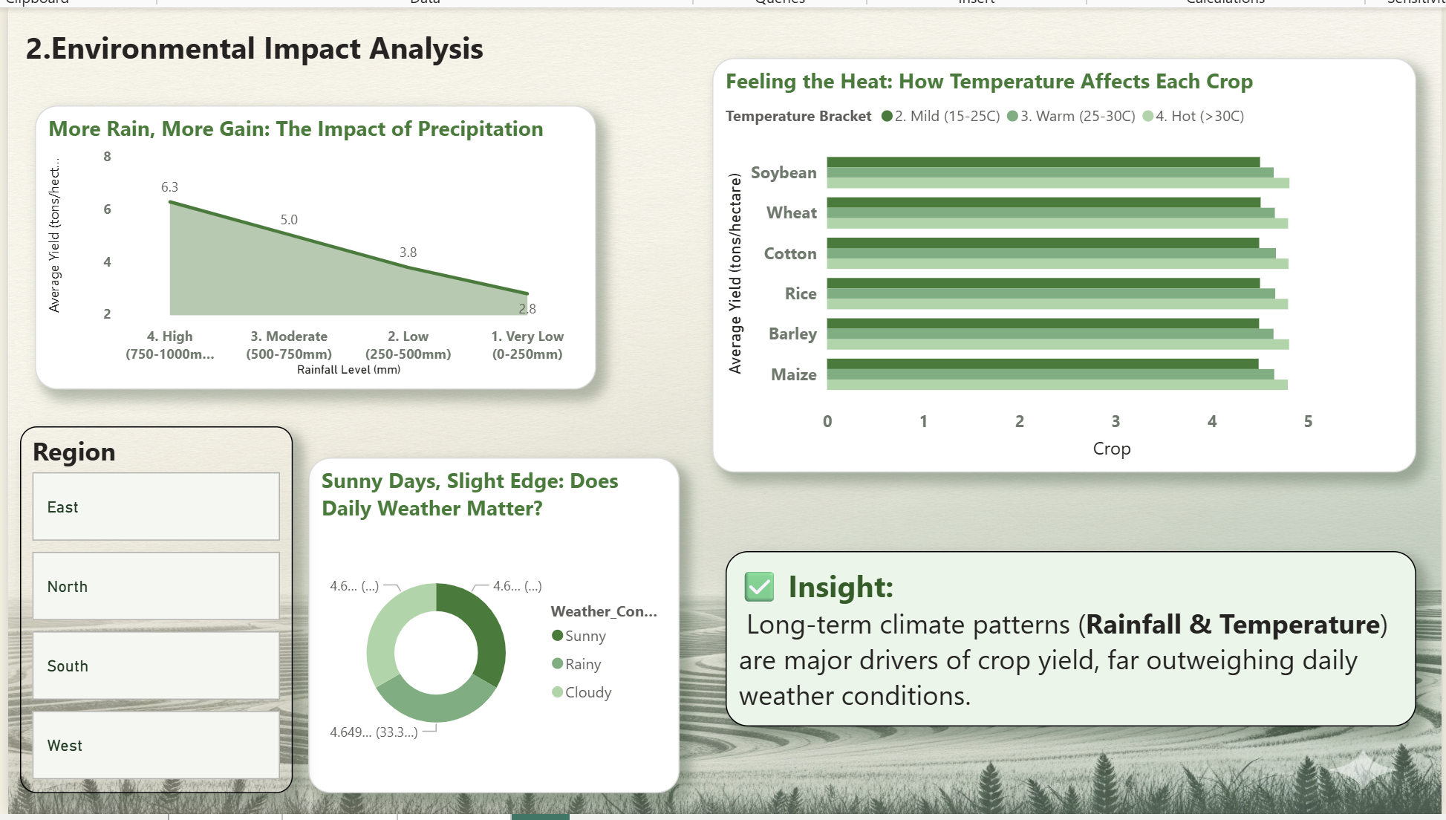

Slide 12
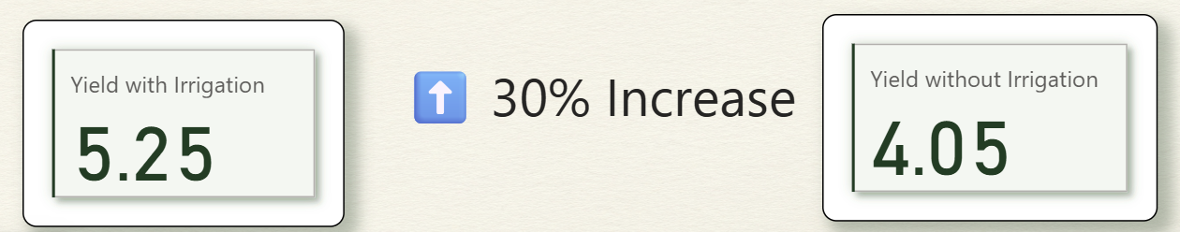
Irrigation: The Single Most Impactful Farming Practice
Our first analysis looked at the usual suspects: the region, soil type, and the crop itself. While we found clear top performers in each category, the data shows their overall impact on yield is surprisingly small. The differences are so minor that they are statistically almost negligible.
Finding 7: Location Doesn't Drive a Major Difference
Finding 2: Soil Type is a Minor Factor
Finding 3: Top Crops Are Neck and Neck

Slide 13
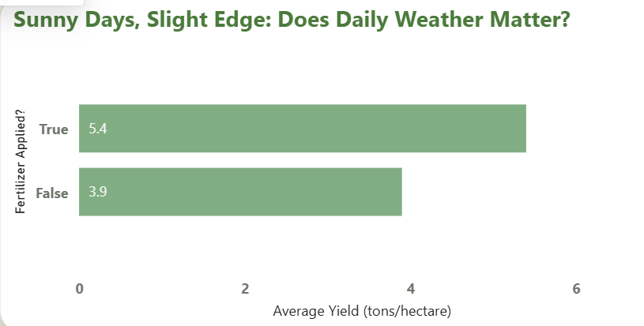
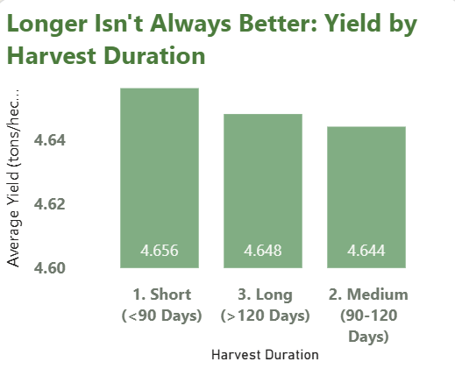
Overall Conclusion
The data is clear: if you're looking for what really drives yield, static factors like region, soil, and crop choice are not the answer. Their total impact on performance is less than 1%.

Slide 14
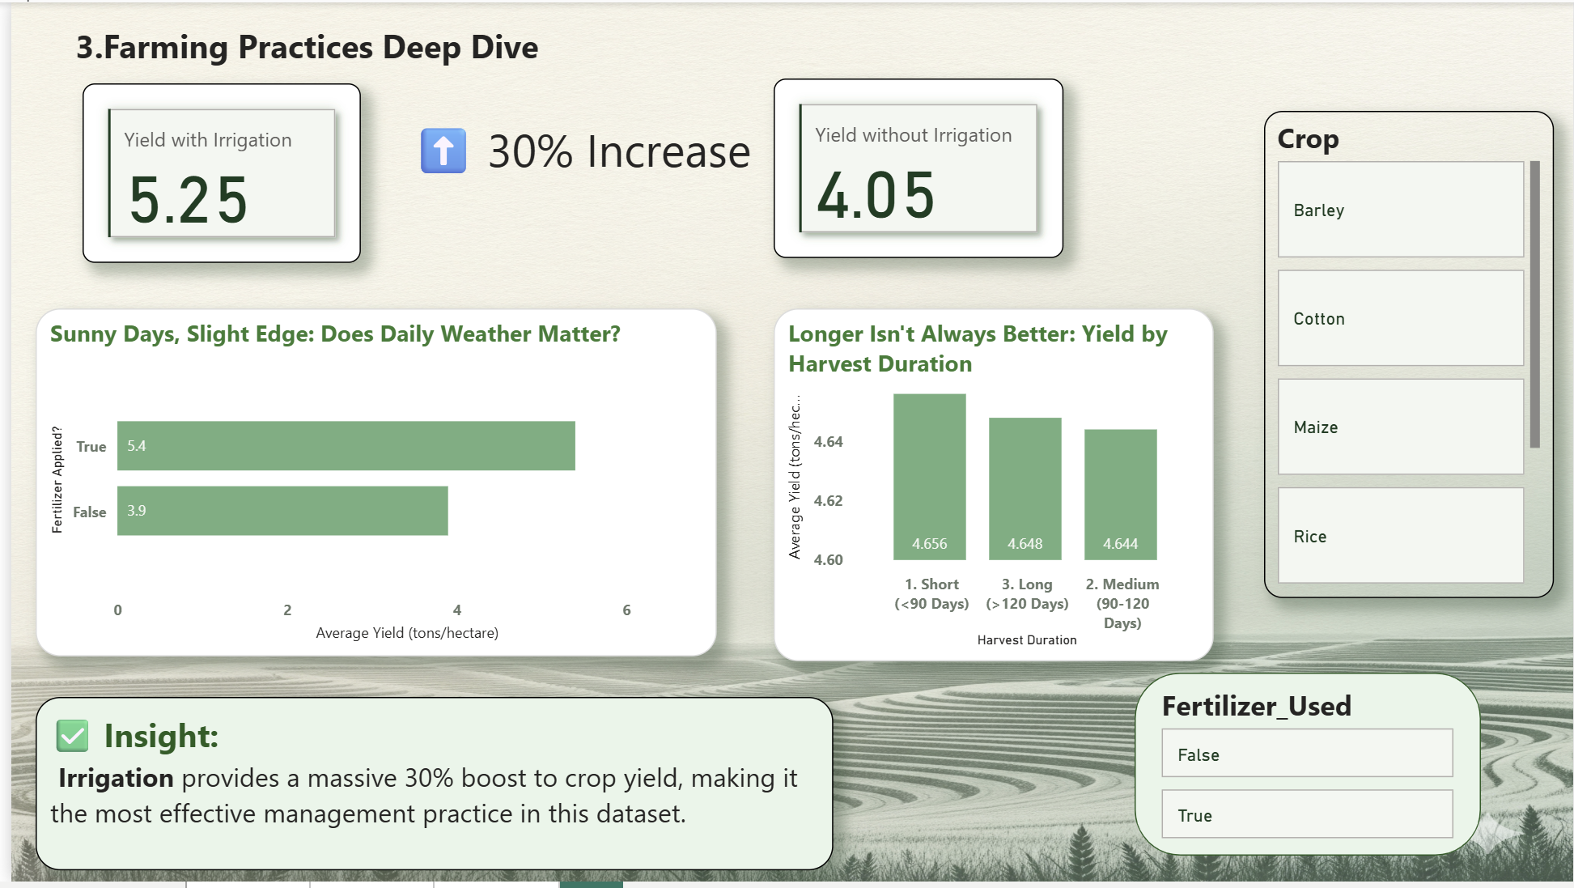

Slide 15
Statistical Confirmation: What Really Predicts the Harvest?
The Predictive Model's Findings
To answer the ultimate question of which factors are the most powerful predictors, a Random Forest predictive model was trained on the entire dataset. The model learned the complex patterns in the data and then ranked each factor based on its contribution to making accurate predictions.
The model found that three key factors account for over 92% of the predictive power in determining crop yield.
Rainfall (60.6% Importance)
Fertilizer (19.6% Importance)
Irrigation (12.5% Importance)

Slide 16
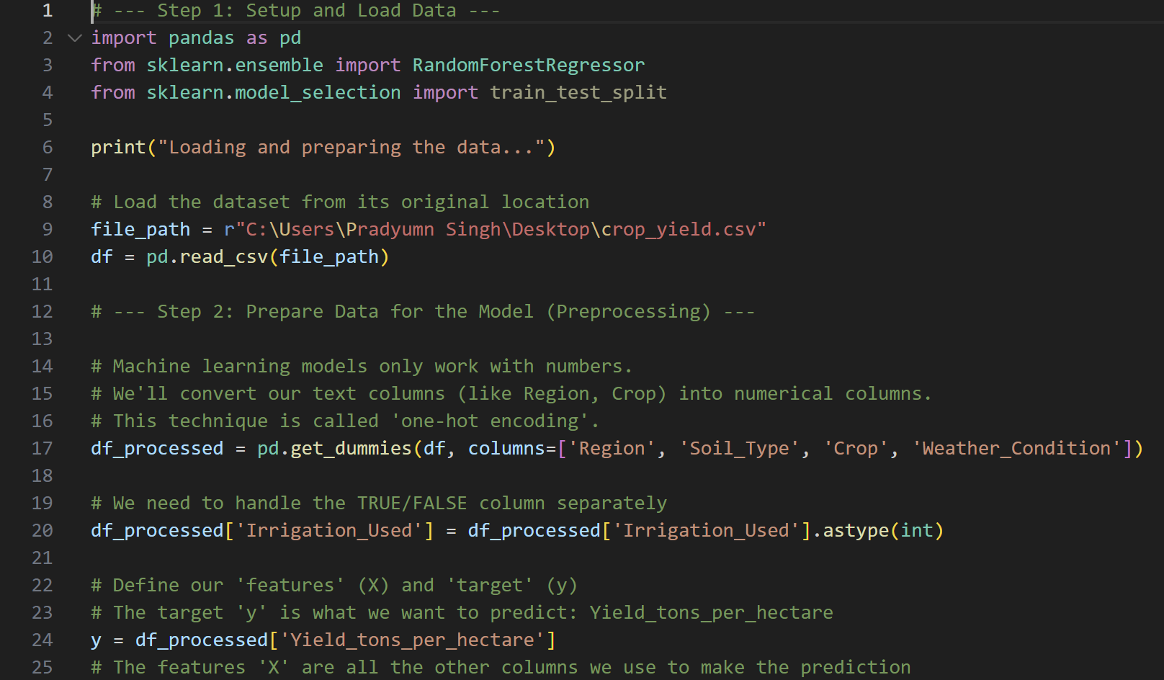
The Big Picture:
The model confirms that water management (Rainfall + Irrigation) and nutrient management (Fertilizer) are the overwhelming drivers of crop yield. All other factors, like Temperature, Region, Soil Type, and daily Weather Conditions, have a comparatively minor predictive impact.

Slide 17
Conclusion & Key Takeaways
Focus on Water Management: It's the most critical factor, both natural (rainfall) and human-controlled (irrigation).
Adapt to Temperature: Warmer is generally better; climate is a key consideration.
Static Factors are for Context, Not Prediction: Use region, soil, and crop choice for context, but don't rely on them as primary drivers of yield.
Recommendation:
For anyone looking to forecast or improve crop yields, the data shows that the primary focus should be on water and heat.

Slide 18

Thank You
Explore the Project Files
You can access the complete Power BI report, this PowerPoint presentation, and all the datasets used in this analysis via the following QR code.

